Slide 1

Effective Project Management: JIRA for Issue and Bug Tracking
Group Members: Samrat Pandey, Suzan Khatri, Ankit Roka,
Nischal Neupane
14 October, 2024

Slide 2



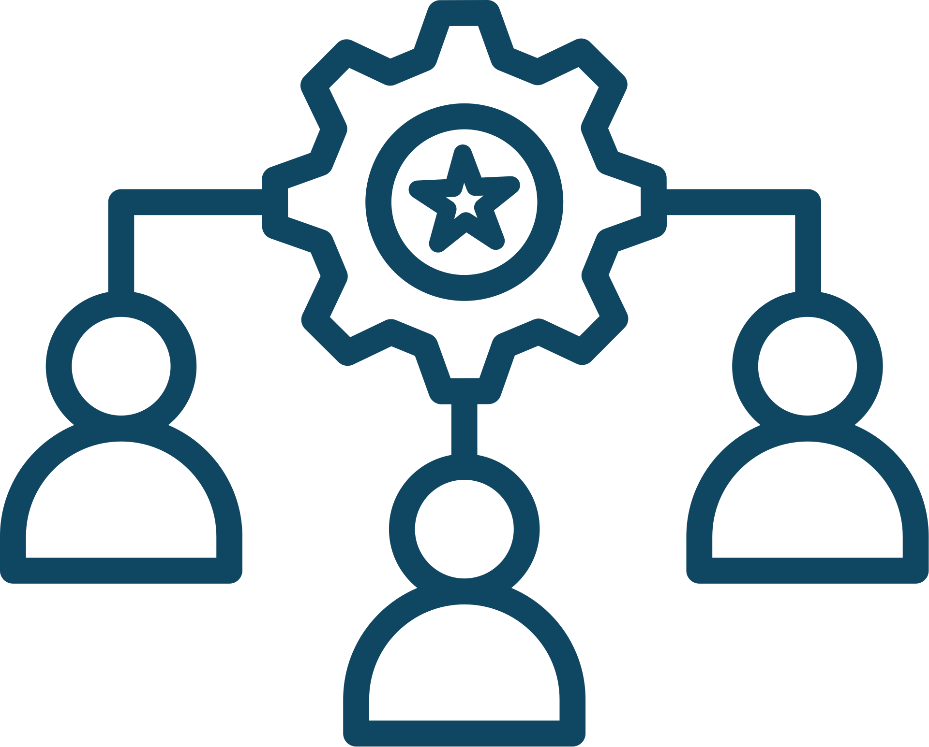
AGENDA
Issue and
bug tracking tools
used
Integrations with Other Tools
Resource Allocation and Workload Balancing
WORKFLOW

Slide 3
Issue and Bug Tracking Tools
Many people consider JIRA to be one of the most feature-rich and reliable tools for managing agile projects, providing flexibility in tracking tasks, issues, bugs, etc overall development of the project.
For software development and project management, JIRA was chosen because of its extensive feature set, which makes it easier for teams to monitor issues and maintain stakeholder alignment.

Slide 4
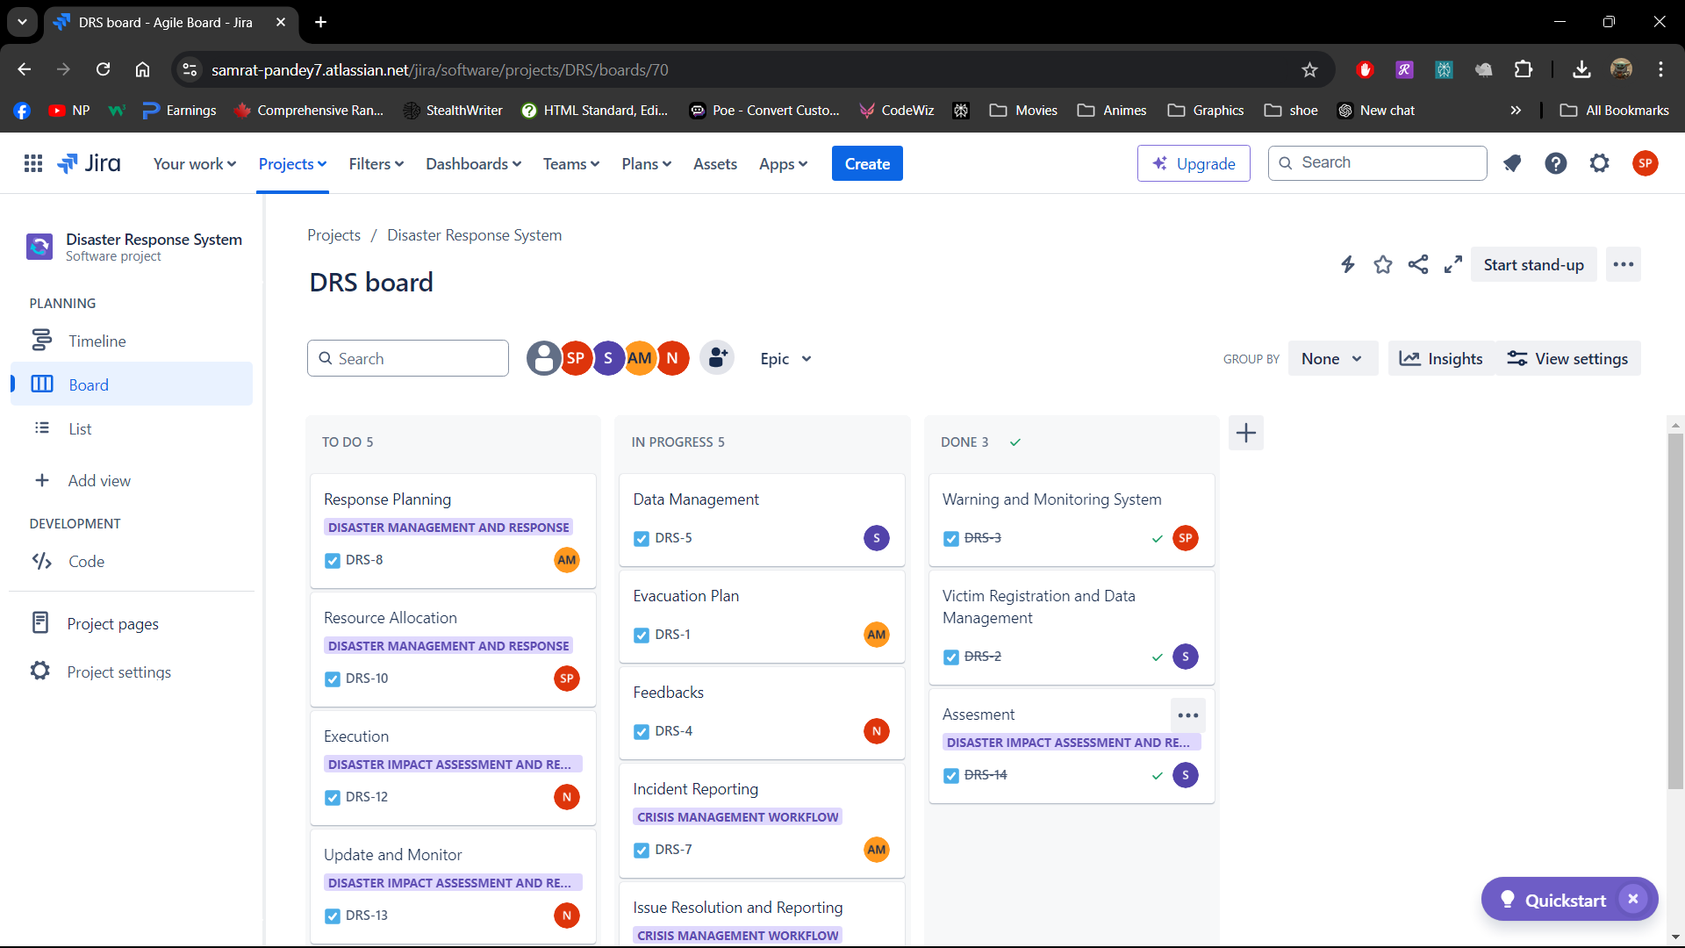
Use of JIRA for Workflow Management

Slide 5
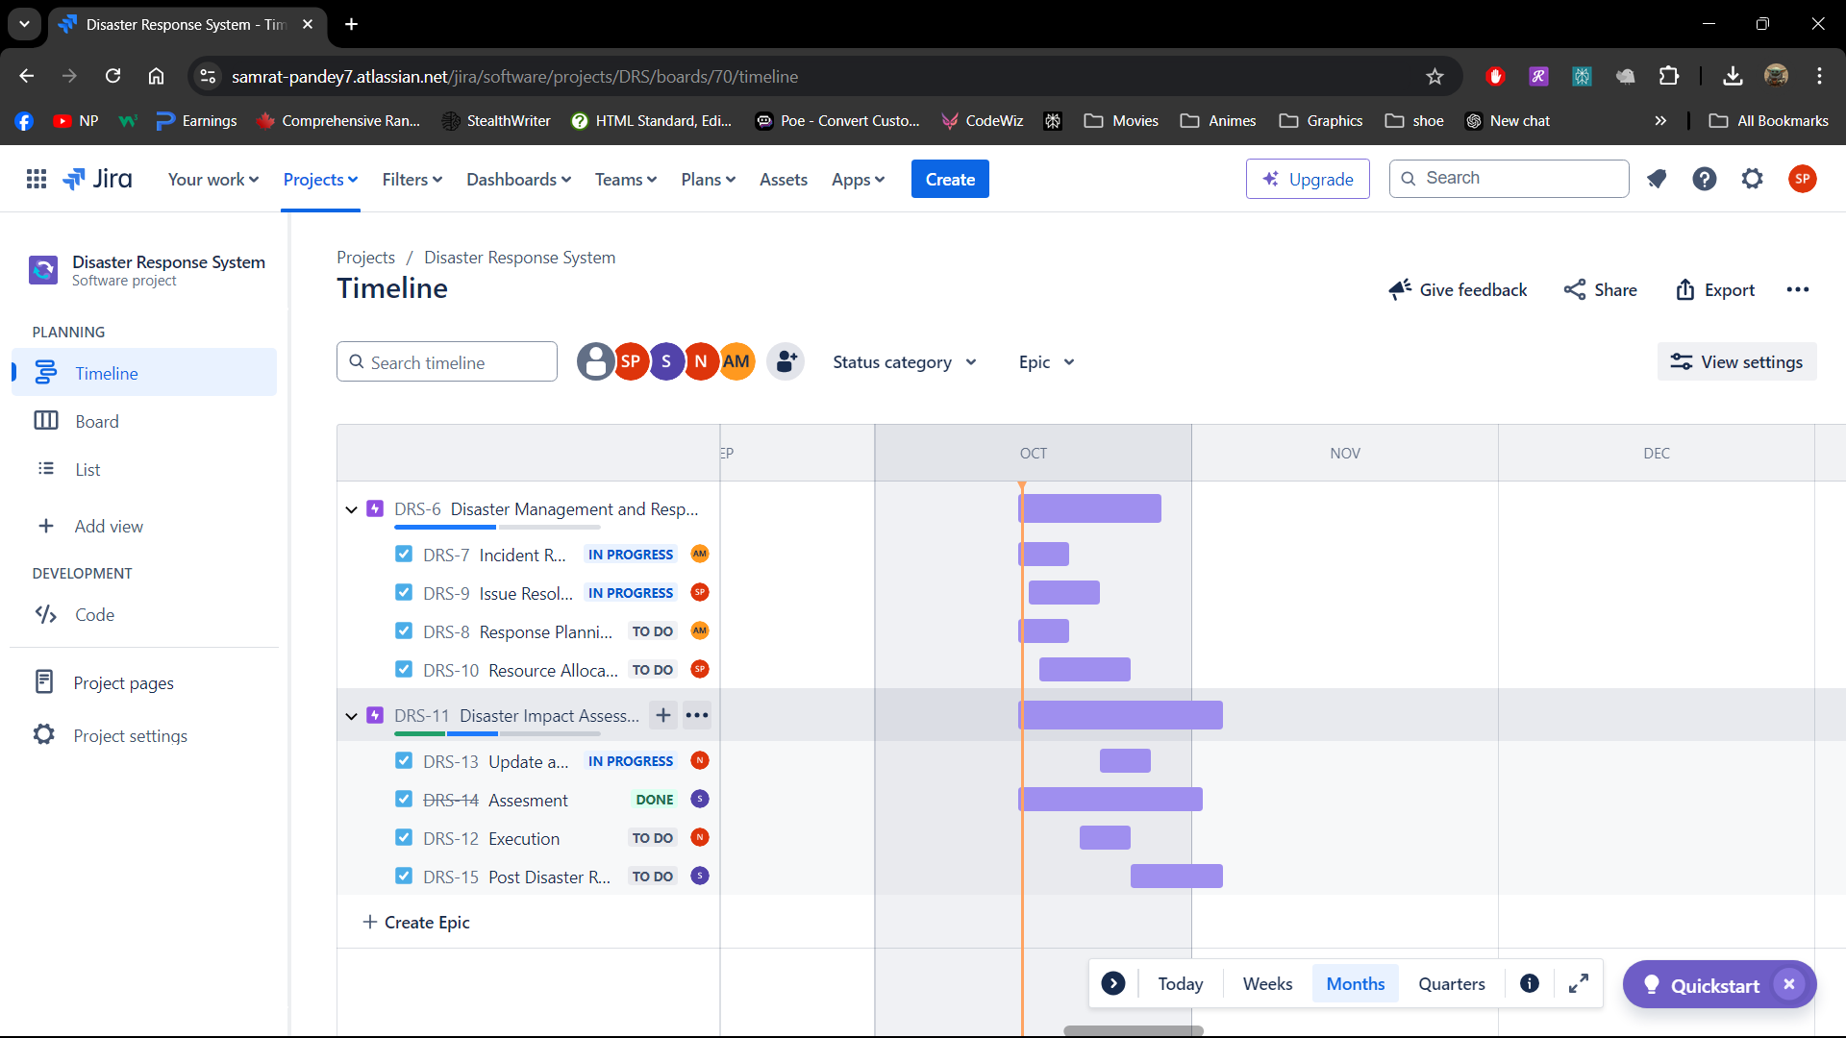
Use of JIRA (Epic and Child Issue Creation)

Slide 6
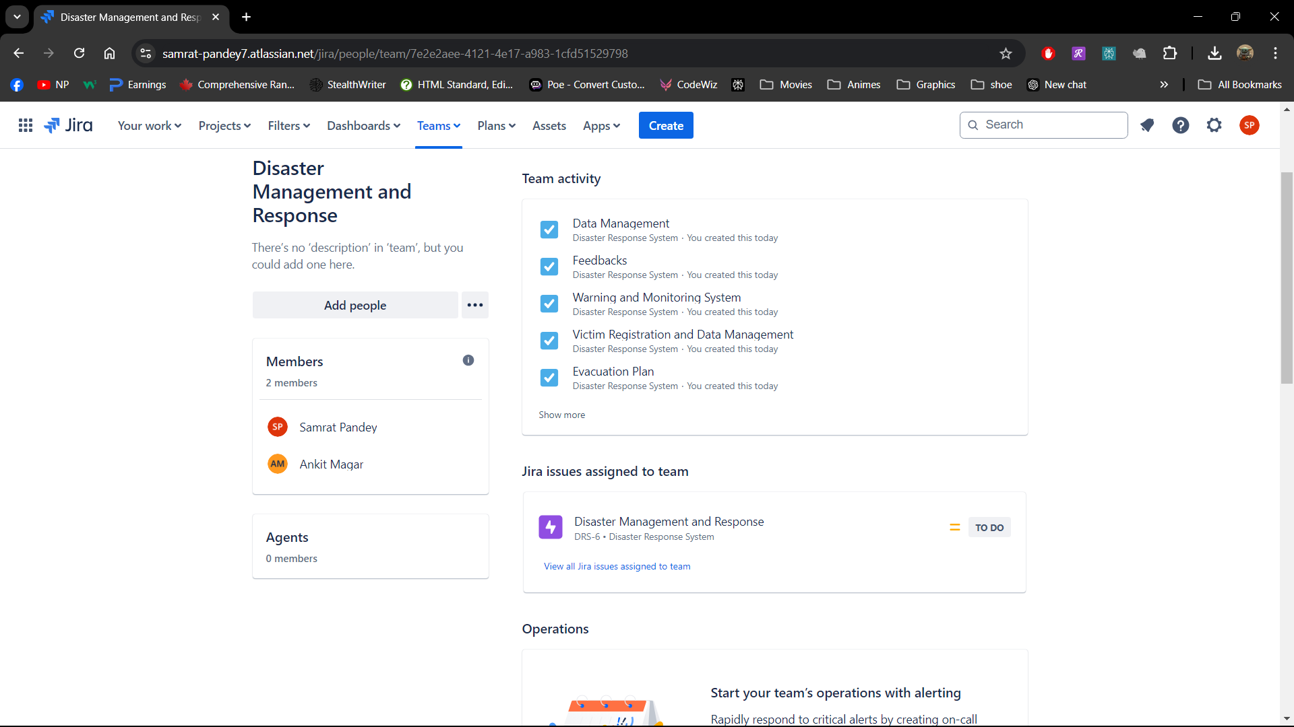
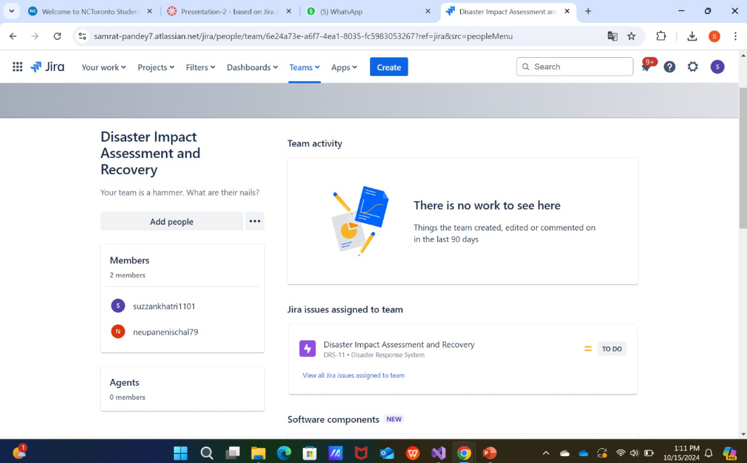
Use of JIRA (Formation of Team and assigning Epic)

Slide 7

KEY FEATURES
Important JIRA Features for Tracking Issues and Bugs:
Effective Bug and Issue Tracking:
Bugs and issues can be tracked, managed, and recorded by teams at any point in the project.
Custom workflows guarantee that issues are tracked in an organized manner (e.g., To Do, In Progress, Done), highlighting the tasks that require attention.

Slide 8
Organizing Tasks:
Projects are divided into tasks and epics, which are then assigned to designated team members in order to guarantee resource transparency and defined roles.
The Kanban board in JIRA keeps track of task progress visually, allowing for real-time modifications and the identification of bottlenecks.
Personalization and Adaptability:
To meet the needs of the project, teams can add phases to workflows, such as testing or review.
To improve task monitoring and insights, project-specific data can be tracked with the use of custom fields and reports.
Connectivity to GitHub:
In order to link repositories and synchronize pull requests, commits, and branches with JIRA issues, JIRA interfaces with GitHub.
Real-time updates between project management and development are ensured via this integration.

Slide 9

WORKFLOW
1.Incident Reported
3.Response planning
New Incident
A disaster event is reported through various channels (e.g., user reports, real-time alerts).
A new JIRA issue is created, with key information like the type of disaster, location, and severity.
Response Plan In Progress
The team develops a disaster response plan, breaking it down into tasks like resource mobilization, rescue operations, and evacuation.
Key tasks such as "send emergency notifications" and "mobilize volunteers" are created in JIRA.
2.Assement
4.Resource allocation
Assessing
The issue is assigned to a team for initial assessment. They evaluate the scope, severity, and resources required for response.
The priority is set based on impact (e.g., Critical, High, Medium, Low).
Resources Assigned
Teams and resources (e.g., medical, rescue, logistics) are assigned specific tasks.
Custom fields can be used to track resources like personnel, vehicles, and supplies.

Slide 10
WORKFLOW
5.Execution
7.Issue Resolution and Reporting
Response In Progress
Teams start executing their tasks (e.g., evacuating people, distributing relief materials). Each task progresses through various stages, such as "To Do," "In Progress," and "Completed."
JIRA’s Kanban board or Scrum features are used to track progress in real-time.
Resolved
Once tasks are completed, the issue is marked as resolved.
Post-disaster, the team conducts a review, document lessons learned and areas for improvement.
Custom reports are generated to analyze response efficiency and resource utilization.
6.Update and monitor
8.Post-Disaster Recovery
Monitoring
Progress is closely monitored. Teams provide real-time updates through comments and attach relevant documents (e.g., photos, reports) to JIRA tasks.
Any challenges or changes in the situation are logged as sub-tasks.
Recovery In Progress
Long-term recovery tasks (e.g., rebuilding infrastructure, providing medical care) are tracked separately.
These are managed as ongoing tasks with milestones.

Slide 11
Integrations with Other Tools
GitHub Integration in JIRA
GitHub is used for the integrations for this project.
JIRA handles issue tracking and project management.
Use of GitHub
We use GitHub to facilitate to our code base as a team
Allowing members to comment, perform commits and make Pull requests among others to our code repository.
When we create a given commit or Pull request on GitHub it is immediately placed in the frame of JIRA where each and every such activity is given a ticket number.
Why this thread is important is because it allows for the changes rolled out to be part of the project in question. In restricting the issue fix or feature implementation a particular line of work is achieved. Instead of opening the several change management requests which could disfigure the water wall.
Indeed, that may be possible, due to the version control, changes can be monitored and repaired. For instance, previous changes can be accessed or even altered if possible.

Slide 12
Integrations GitHub
Image

Slide 13
Resource Allocation and Work Balancing
We structured the workload among team members to ensure everything runs smoothly and no one is overwhelmed.
Team Roles
Samrat: Creation of DRS Board and overseeing most of the Board timeline.
Sujan: Handled GitHub repository creation and connected with Jira.
Ankit: Gathering of Data for Presentation and Board creation along with helping with PowerPoint.
Nischal: Handled most of PowerPoint and communicated with everyone.
Workload Balancing
To balance the workload, we use JIRA and workload reports to keep track of everyone’s task load.
Samrat: 90% JIRA, 5% GitHub, 30% database tasks.
Sujan: 95% GitHub, 10% documentation.
Ankit: 70% database tasks, 10% JIRA, 30% PowerPoint, 10% documentation.
Nischal: 70% PowerPoint, 80% documentation.
We also adjust tasks daily during our sprint reviews to ensure that no one is overworked."

Slide 14
SUMMARY
Direct measures were taken to complete the project of Disaster Management System in a structured way, with well-defined epics and tasks that were designated for members of the team for clarity. There was the application of JIRA for cases tracking, incorporating it into GitHub for coordination of codes with the tasks JIRA Webb application was in itself, the coding issue tracking. Attending daily meetings or receiving up to date status through JIRA assists in notifying the team. The issue of task overlap has been solved by the use of role assignments, whereas the issue relating to task progress is improved by using JIRA and GitHub. Such approaches have also improved the ease with which teamwork is done when managing a project.

Slide 15
References
GitHub Documentation. (2024). Integrating JIRA with GitHub for Seamless Project Management.
https://docs.github.com/en
GitLab Documentation. (2023). Version Control and Collaboration: Integrating GitLab with Project Management Tools.
https://docs.gitlab.com/ee/integration/jira/
Smith, J., & Taylor, R. (2021). Improving Disaster Response with Technology. International Journal of Emergency Management, 15(4), 202-217. https://www.inderscience.com/jhome.php?jcode=ijem
Sharma, P., & Gupta, A. (2022). Agile Project Management with JIRA and GitHub. https://www.springer.com/gp/book/9783030744978

Slide 16
Thank you

